Slide 1
Introductory thoughts on Bayesian analyses: examples in JAGS
Kyle Wilson
(a non-expert in Bayesian methods)

Slide 2
Different ways to make probabilistic claim
Frequentist
Bootstrapping (Monte Carlo method)
Likelihood profiling
Bayesian (Sampling-Importance-Resampling)
Bayesian (Markov Chain Monte Carlo)

Slide 3
Bayesian v. Frequentist
Frequentist
Sampling is infinite
Decision rules are sharp
Data are a repeatable random sample
i.e., there is a frequency of events
Underlying parameters are fixed, and by repeating the sampling we can eventually know truth
Bayesian
Unknown quantities are treated probabilistically
State of the world can be updated
Prior state v1 -> data v1 -> posterior state v1 -> updated prior state v2 -> data v2 …
Data are observed from the realized sample
There are no underlying parameters
Parameters are unknown and described probabilistically
Data is fixed
To err and err and err again, but less and less and less

Slide 4
What is the goal of estimating parameters of a model?
Making a claim of cause–effect?
Often want to report one value for simplicity
Examples for slope of relationship
A 10 m increase in elevation leads to a 5% decline in seed set
Density reduced by half leads to a 100% increase in growth
Good for confident description of governing rules of biology
Can use any approach that helps address the cause-effect
Simplifying approaches makes for terrible predictions

Slide 5
Practical reasons to go Bayesian
Want to make predictions or forecasts
Bayesian approaches often are best ways to account for uncertainty
Parameters estimated probabilistically rather than optimally
Parameters are correlated
Use posterior outcome to understand correlations
No single ‘most likely’ answer
Many ‘equally good’ combinations
Want to include prior data formally
Data-limited context
Hierarchical model
Partial-pooling
Shrinkage
Meta-analyses
Study of studies
Still a hierarchical model

Slide 6
Philosophical reasons to consider Bayesian
There is no truth, only degrees of truth
We can’t ever know what is true, we can only assign credibility or probabilities of truth
Coefficients/parameters arise randomly from a distribution of truth, and are described probabilistically to the observed data
Versus…
There is underlying truth, and we can know it if we could only sample ad infinitum

Slide 7
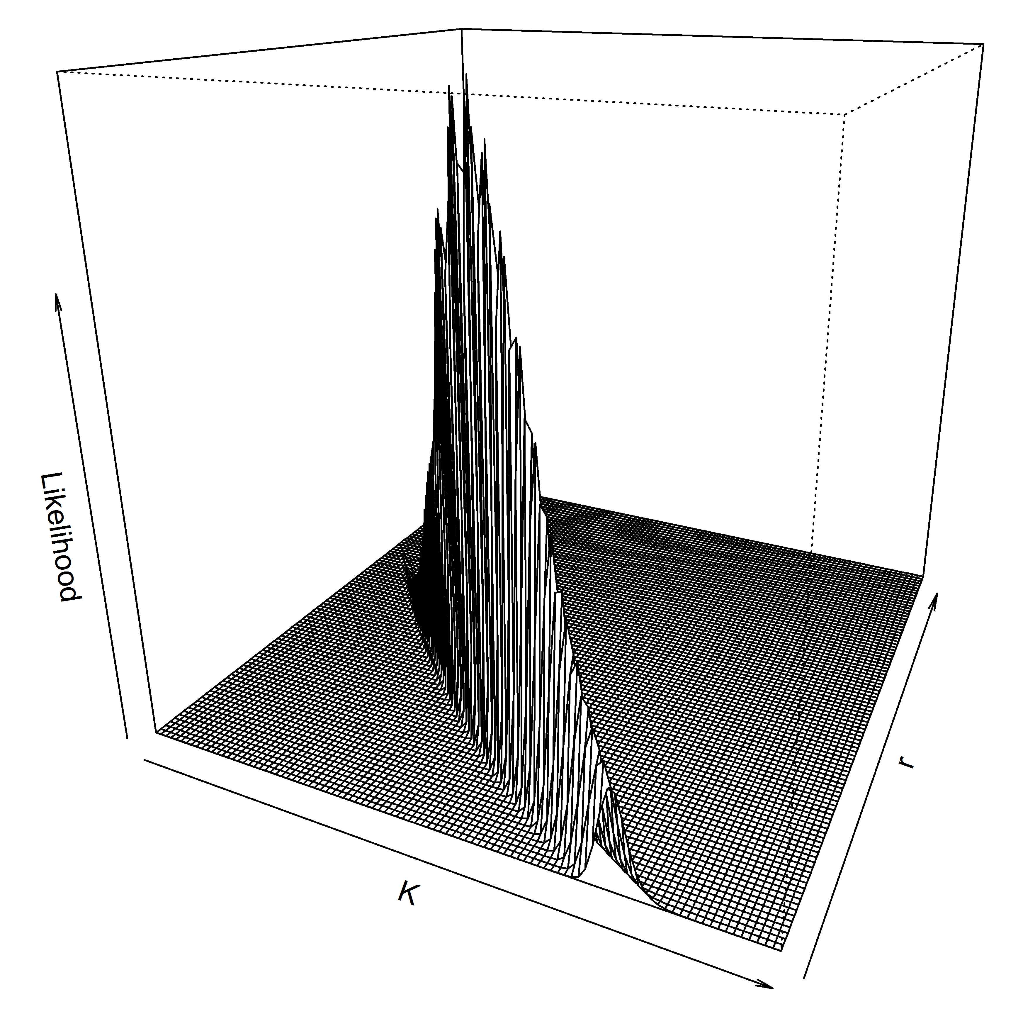
Example problem: where is the truth?

Slide 8
MCMC – the goal
We use Markov Chain Monte Carlo to explore and describe the posterior’s ‘mountain’
To trust a posterior, the MCMC chains need to converge on a stable distribution
No autocorrelation in chain
Different chains reach the same distribution
An arbitrary midway point of the chain should be statistically drawn from the same distribution as the end of the chain

Slide 9
MCMC: how does it work?
Start at an initial vector of parameter estimates
Calculate posterior density
Jump (using a jump algorithm) to a new vector
Random (or non-random?) jump away from current vector
Calculate posterior density of new vector
Stay at the new vector and proceed onward:
If new vector has higher posterior density or
At a probability based on the ratio of the new to the initial posterior density
Repeat

Slide 10
Visualizing MCMC cycle
r=2.49;
Accept the new point.

Slide 11
Visualizing MCMC cycle
r=0.5;
Accept the new point
with probability 0.5

Slide 12
MCMC: how does it work?
Starting vector
First “few” points

Slide 13
MCMC – the diagnostics
Determining convergence is art, not science
Do not use only one test
All available in the {coda} library package
Geweke test
Gelman-Rubin test
Currently most preferred
Heidelberger-Welch test
Autocorrelation test
Raftery-Lewis test
Effective sample size test
N posterior samples
Autocorrelation means you have M independent samples
Is M << N ?
Bad MCMC

Slide 14
The jump function algorithm
Best if it is efficient
Don’t jump to areas you already explored
Don’t jump to areas that have 0 probability
Some much more efficient than others
Hamiltonian (HMC) is most efficient because it is not a random-walk
Determines software choice
BUGS & JAGS use Gibbs-sampling for conjugate priors
JAGS uses AR Metropolis for non-conjugate
Conditional updating parameters one-by-one
SLOWWWWW, but very stable
ADMB & TMB
Uses Metropolis but can include mixture (TMB now has Hamiltonian)
STAN
Uses Hamiltonian (want to learn this!)

Slide 15
Bayesian in practice
Posterior = Prior + Likelihood
Probability densities in log-space
Prior must be specified as a distribution
e.g., dnorm() with a mean of x, and an sd of y
Likelihood is a distribution as well
Software choice dictates how this can be implemented
JAGS/BUGS doesn’t allow for customized likelihoods
No way to simply do sums-of-squares

Slide 16
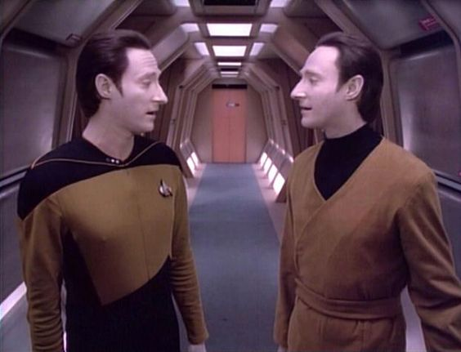
Bayesian in practice
Do you have
Good Data or Bad Data?
Choice of prior has important consequences on inference
Informative prior is good and bad
Good: you have a previous idea of what to expect
Bad: the prior might become your outcome (posterior)
Uninformative prior is good and bad
Good: you let your data do the talking
Bad: your data sucks and tells you to jump off a cliff

Slide 17
Bayesian in practice
Choice of prior has important consequences on inference
Uniform priors says that across a range of x to y, all outcomes are equally likely
Good if we want this
Bad because it might make computations slower than they need to be
Binomial event: 0 or 1
Event occurs with probability p
p is bounded between 0 and 1
p ~ dunif(0,1) ?
p ~ dbeta(0.001, 0.001) ?
More informative than dunif()
Still not very informative at all
Haldane prior

Slide 18
Bayesian hypothesis testing and model comparisons
Simply look at 95% credible intervals for the coefficient of interest
Do the intervals cross 0?
Bayes Factor
Good for null hypothesis testing
Not easy to implement for most complex models
Easy enough for regressions
Andrew Gelman hates Bayes Factor
DIC
Analogue to AIC
Very easy to implement
Posterior predictive checks
Leave-one-out cross-validation

Slide 19
Example linear regression
Simulate noisy data
Y_{i} ~ m·x_{i} + b
N = 20, 50, 100
Can we recover m, b, and the variance term in the 95% Credible Intervals?
Not confidence intervals

Slide 20
Example breakpoint regression
Simulate noisy data
Y_{i} ~ m1·x_{i} + b1; x < breakpoint
Y_{i} ~ m2·x_{i} + b2; x > breakpoint
N = 30, 500, 100
Can we recover the parameters in the 95% Credible Intervals?
6 parameters
m1, m2, b1, b2, the breakpoint, and variance

Slide 21
Hierarchical model
Hierarchical:
Mixed-effects model
State-space model
Some parameters have a group-level distribution
Partial pooling of those parameters that share the group
Shrinkage effect
Estimates are pulled towards the group-mean as a result of their common group distribution
Strong data, and lots of data for population i among group j will keep it ~independent of group-mean

Slide 22
Bayesian random effects
All parameters are random variables in Bayesian models
Random effects only differ from fixed effects by:
Each fixed effect arises from its own distribution, independent of other distributions
Might be numerically the same, i.e., N ~ (0,1)
Each random effect arises from the distribution of its group

